Slide 1

Data Communication and Computer Network BLM3051
Dr. Öğr. Üyesi Furkan ÇAKMAK

Slide 2

Lecture Information Form - Weekly Subjects
BLM3051
Data Communication and Computer Network - 14
Hafta | Tarih | Konular
1 | 20.02.2024 | Introduction to Data Communication Standards Used on Data Communication, Architectural models
2 | 27.02.2024 | OSI Reference Model , Layers and Their Functions, Signaling and Signal Encoding
3 | 05.03.2024 | Parallel and Serial Transmission, Communication Media and Their Technical Specs., Multiplexing (TDM, FDM)
4 | 12.03.2024 | Error Detection and Error Correction Techniques, Data Link Control Techniques, Flow Control
5 | 19.03.2024 | Asynchronous and Synchronous Data Link Protocols (BSC, HDLC)
6 | 26.03.2024 | LAN Technologies Continued, IEEE 802.4, 802.5, 802.11
7 | 02.04.2024 | Connectionless and Connection Oriented Services, Switching
8 | 09.04.2024 | Tatil – Ramazan Bayramı Arifesi
9 | 16.04.2024 | 1. Ara Sınav
10 | 23.04.2024 | Tatil – 23 Nisan Ulusal Egemenlik ve Çocuk Bayramı
11 | 30.04.2024 | Static and Dynamic Routing, Congestion in the Network Layer, Its Causes and Solutions
12 | 07.05.2024 | IP (Internetworking Protocol), ICMP, BOOTP, DHCP
13 | 14.05.2024 | 2. Ara Sınav
14 | 21.05.2024 | UDP (User Datagram Protocol), TCP (Transmisson Control Protocol)
Dr. Öğr. Üyesi Furkan ÇAKMAK

Slide 3
Transport Layer
BLM3051
Data Communication and Computer Network - 14
The Internet
UDP (User Datagram Protocol)
TCP (Transmission Control Protocol)
Dr. Öğr. Üyesi Furkan ÇAKMAK

Slide 4
UDP (User Datagram Protocol)
BLM3051
Data Communication and Computer Network - 14
A Connectionless Protocol
Nothing beyond sending pack- ets between applications.
Letting applications build their own protocols on top
Sending datagrams
UDP transmits segments consisting of an 8-byte header
Using only raw IP, not ports
So, the transport layer would not know what to do with each incoming packet.
UDP Header
16-bits | 16-bits | 16-bits | 16-bits
Source Port | Destination Port | UDP length | UDP checksum
Dr. Öğr. Üyesi Furkan ÇAKMAK

Slide 5
UDP (User Datagram Protocol) (Con’t)
BLM3051
Data Communication and Computer Network - 14
The IPv4 pseudoheader (in IP layer, we are in transport layer)
Source and destionation address is 32-bits
No checksum (00000000)
Protocol = 17
UDP length: 16-bits
UDP does not do
Flow control
Congestion control
Retransmission
UPD does do
Optional end-to-end error detection (with Checksum)
An interface to the IP protocol with the added feature of demultiplexing multiple processes using the ports
Dr. Öğr. Üyesi Furkan ÇAKMAK

Slide 6
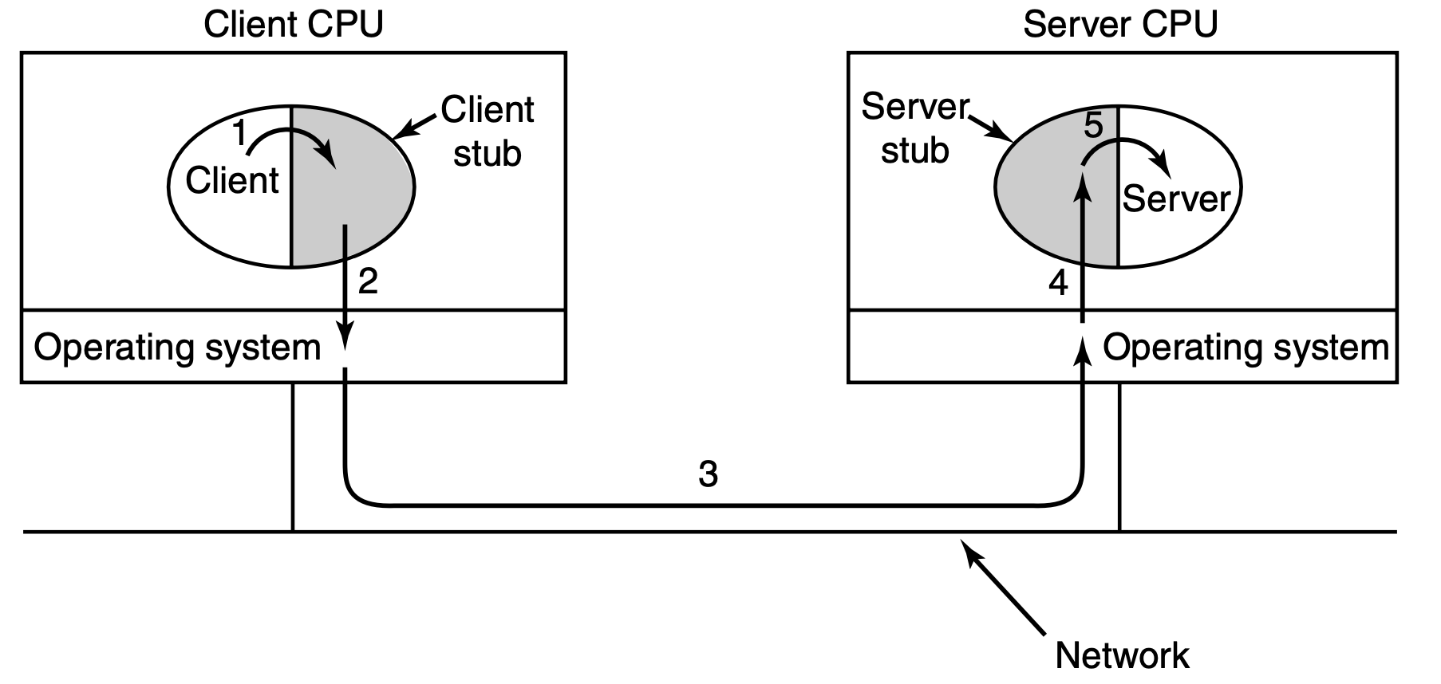
UDP (User Datagram Protocol) (Con’t)
BLM3051
Data Communication and Computer Network - 14
*Andrew S. Tanenbaum - Computer Networks
DNS (Domain Name System) uses UDP
www.ce.yildiz.edu.tr
Remote Procedure Call
Not traditional function call
Client – Server relationship
The calling procedure is known as the client
The called procedure is known as the server
Client stub: represents the server procedure in the client’s address space.
Packing the parameters is called marshaling.
Similarly, the server is bound with a procedure called the server stub.
Dr. Öğr. Üyesi Furkan ÇAKMAK

Slide 7
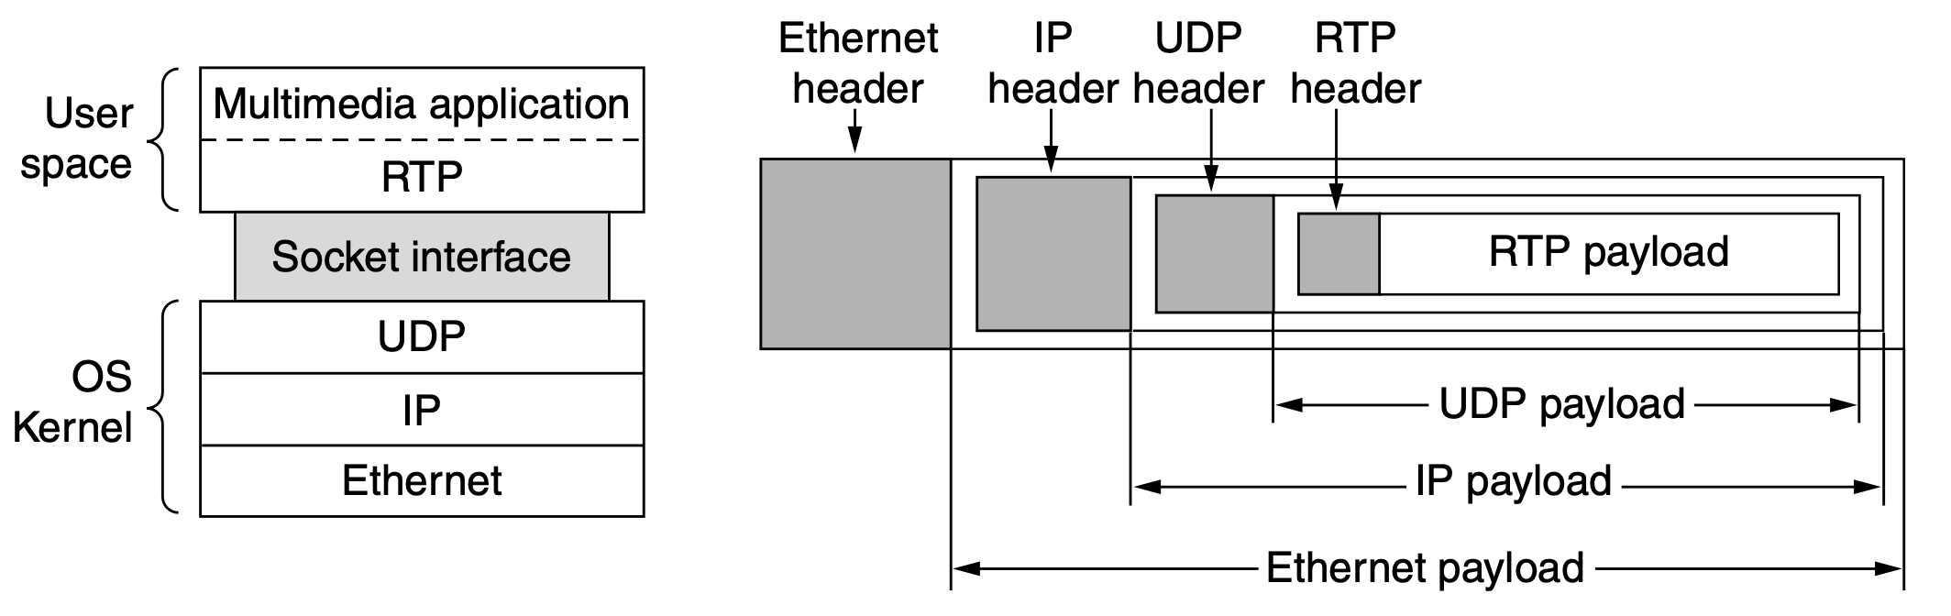
UDP (User Datagram Protocol) (Con’t)
BLM3051
Data Communication and Computer Network - 14
Real-Time Transport Protocols
For real-time multimedia applications.
Internet radio,
Internet telephony,
Music-on-demans,
Videoconferencing,
Video-on-demand.
*Andrew S. Tanenbaum - Computer Networks
Dr. Öğr. Üyesi Furkan ÇAKMAK

Slide 8
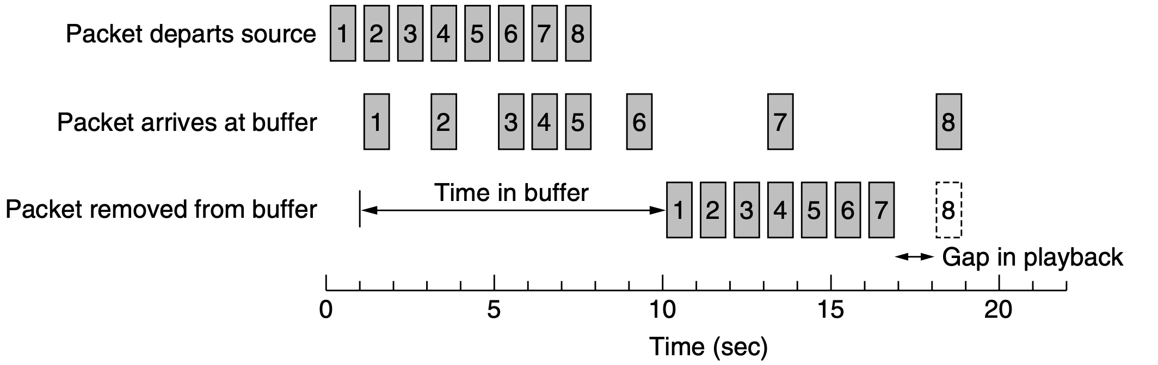
UDP (User Datagram Protocol) (Con’t)
BLM3051
Data Communication and Computer Network - 14
Jitter and Buffer relationship
*Andrew S. Tanenbaum - Computer Networks
Dr. Öğr. Üyesi Furkan ÇAKMAK

Slide 9
Transport Layer
BLM3051
Data Communication and Computer Network - 14
The Internet
UDP (User Datagram Protocol)
TCP (Transmission Control Protocol)
Dr. Öğr. Üyesi Furkan ÇAKMAK

Slide 10
TCP (Transmission Control Protocol)
BLM3051
Data Communication and Computer Network - 14
UDP is a simple protocol
But for most Internet applications, reliable, sequenced delivery is needed
TCP
is a reliable end-to-end byte stream over an unreliable internetwork.
defined in September 1981.
Extensions for high-performance
Selective acknowledgements
Congestion control
Repurposing of header fields for quality of service
Improved retransmission timers
Explicit congestion notification
Dr. Öğr. Üyesi Furkan ÇAKMAK

Slide 11
TCP (Transmission Control Protocol) (Con’t)
BLM3051
Data Communication and Computer Network - 14
Well-known ports:
Port numbers below 1024 are reserved for standard services
Over 700 have been assigned.
Port | Protocol | Use
20, 21 | FTP | File transfer
22 | SSH | Remote login, replacement for Telnet
25 | SMTP | Email
80 | HTTP | World Wide Web
110 | POP-3 | Remote email access
143 | IMAP | Remote email access
443 | HTTPS | Secure Web (HTTP over SSL/TLS)
543 | RTSP | Media player control
631 | IPP | Printer sharing
Dr. Öğr. Üyesi Furkan ÇAKMAK

Slide 12
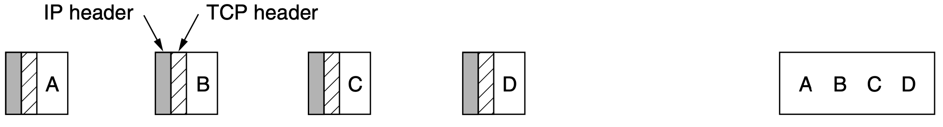
TCP (Transmission Control Protocol) (Con’t)
BLM3051
Data Communication and Computer Network - 14
All TCP connections are full duplex and point-to-point.
TCP does not support multicasting or broadcasting.
A TCP connection is a byte stream, NOT a message stream.
*Andrew S. Tanenbaum - Computer Networks
Dr. Öğr. Üyesi Furkan ÇAKMAK

Slide 13
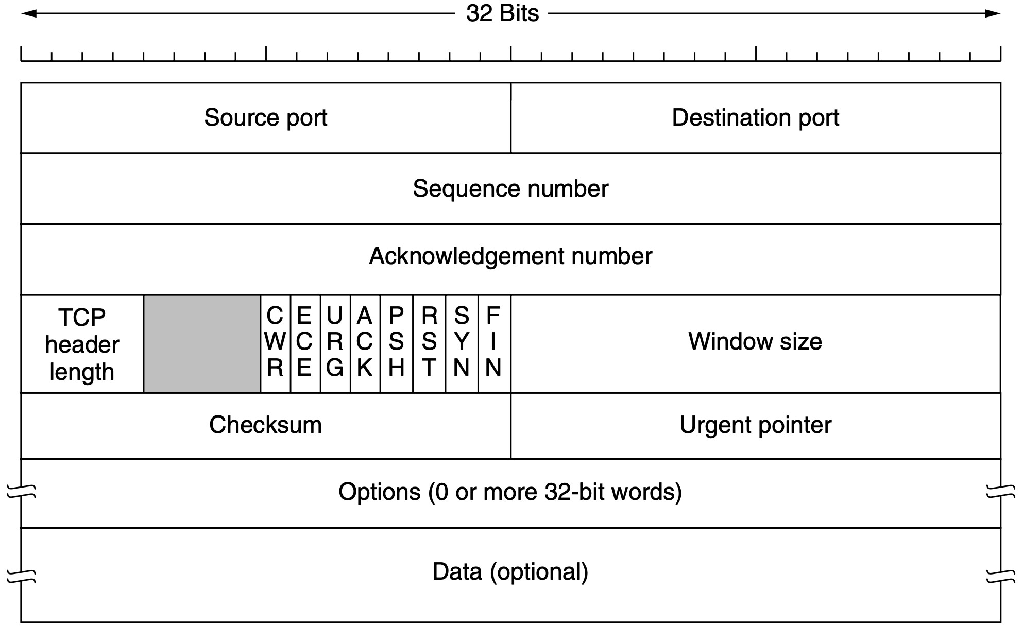
TCP (Transmission Control Protocol) (Con’t)
BLM3051
Data Communication and Computer Network - 14
The TCP Segment Header
*Andrew S. Tanenbaum - Computer Networks
Dr. Öğr. Üyesi Furkan ÇAKMAK

Slide 14
TCP (Transmission Control Protocol) (Con’t) The TCP Segment Header
BLM3051
Data Communication and Computer Network - 14
*Andrew S. Tanenbaum - Computer Networks
TCP header size is 20 bytes.
IP header ize is 20 bytes.
65535-20-20 = 65,495 bytes data.
This connection identifier is called a 5 tuple
The protocol (TCP)
Source IP
Source port
Destination IP
Destination port
TCP segments: 536 + 20 = 556 bytes
Dr. Öğr. Üyesi Furkan ÇAKMAK

Slide 15
Thank you for your listening.
BLM3051
Data Communication and Computer Network - 14
Dr. Öğr. Üyesi Furkan ÇAKMAK

